Slide 1
Opioid Overdose Prediction: Different Predictors
B5
Jungin Hong
Lanting (Polaris) Li
Ali Al-Hakeem
Amberly Briones

Slide 2
Quarterly opioid problems
and economic factors in CA
7 economical features - independent variables, e.g. House Price Index, Annual Income
8 possible targets (opioid overdose indexes): variables that we want to predict using economical features, e.g. Hospitalization annualized quarterly rate, ED visits counts
Plot correlation between them to find out the strongest relation

Slide 3
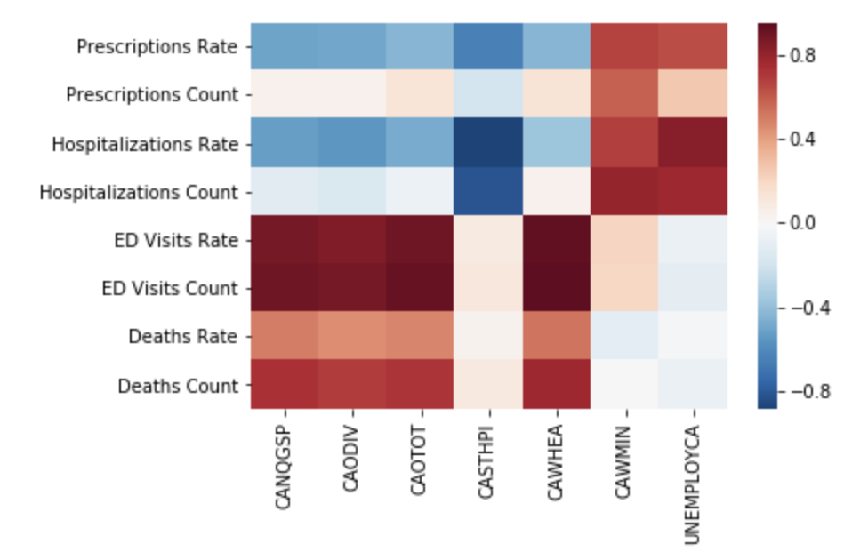

Slide 4
Create Models using selected input & output target
Using single independent variable to Linear Regression:
Healthcare and Social Assistance Wages → ED visits: 0.882193
House Price Index → hospitalization: 0.715172
Using all features:
Random Forest Regression → hospitalization: 0.743464
Lasso Regression → hospitalization: 0.768203

Slide 5
Benefits: Economics & opioid overdose
How economic factors contribute to opioid overdose and misuse
For example: Healthcare and Social Assistance wages → ED visits
Positive correlation between economic factor and opioid misuses
No prediction models that can be used
Our model is readily available to be used by professionals
Real time data to predict future trends
Economy is constantly changing, will provide new data and trends
For example, if a recession happens there will be a loss of wages and employment
Public health officials can predict how many people will misuse opioids by using the model→ prevention

Slide 6
Use twitter emotional cues to predict monthly death counts in US
10,000 tweets from US in each month: .json
41 .txt file:
Combine tweets content
41 dictionary:
Word frequency.
Drop empty entries:
41 X 264
41 X 315 matrix

Slide 7
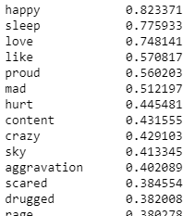
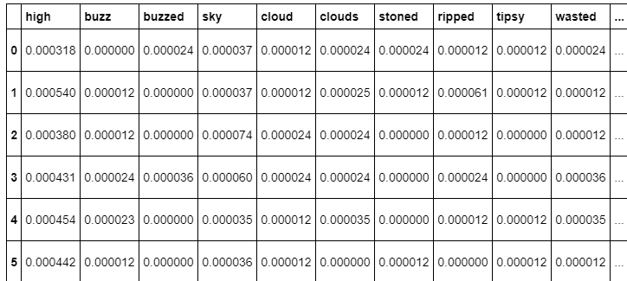
Monthly emotional word detection(tweets) and opioids death in U.S
DATA PREPROCESSING
262 emotional words → array: top 50 words (sorted: absolute correlation)
10,000 tweet posts → matrix: word count and frequency

Slide 8
Model choosing and R-squared
Using single word to predict:
Linear Regression (“happy”) : 0.759197
Using Multiple words to predict:
Random Forest: 0.738168
Lasso Regression: 0.359169
Logistic Regression: -3.560888
Gaussian process Regression: 0.121400
Stochastic Gradient Descent: -48.970228
Multi-layer perceptron regressor: -156.288127

Slide 9
Benefits: Emotional Word Tweets & Opioids
Many research: the relation between emotion and drug abuse
Positive relation between emotion and drug use
Individual prediction model, no overall model
Overall model can help allocate medical and human resources
By using emotion cues, we can predict the number of opioid overdose
Twitter data → social media becomes more prevalent

Slide 10
Findings and conclusion
What we want to do through these two parts of our project is to test and find out if predictors in different areas can help to predict the overall level prediction for opioid overdose. For here, we include only economic cues and emotional cues from social media. But for future study, we can try other different features, such as population, gross national happiness, or education level. We want to see if it is possible to build an accurate model that considers about many different aspects in our society.
Aim to build an accurate model in the future that considers many different aspects in the society
- Add normalization , add geography information

